Slide 1
PERSON RE-IDENTIFICATION USING DEEP LEARNING AND BIG DATA METHODS
PRESENTED BY:
ANANDHU S KUMAR
B AKASH KRISHNA
JEWEL SAJI

Slide 2
INTRODUCTION
PERSON RE-IDENTIFICATION USING DEEP LEARNING AND BIG DATA METHODS
In today’s world, surveillance plays a crucial role in maintaining safety and security. However, manually analyzing hours of video
footage is time-consuming and inefficient. This project aims to automate the detection of missing persons and violent activities in
video footage using deep learning-based face recognition and action recognition models
Key Objectives:
Identify missing persons by comparing detected faces in video footage with reference images.
Detect violent activities in real-time to enhance public safety.
Utilize deep learning (MTCNN for face detection and InceptionResnetV1 for face recognition) for accurate results.
Improve response time by automating surveillance and reducing human intervention.
By leveraging AI-powered solutions, this system enhances video surveillance, making it faster, more efficient, and highly reliable.
Dept.of CSE,MACE,Kothamangalam
2

Slide 3
PROBLEM STATEMENT
PERSON RE-IDENTIFICATION USING DEEP LEARNING AND BIG DATA METHODS
Investigating missing persons or identifying suspected criminals often requires analyzing hours of CCTV footage, which is time-consuming
and inefficient. Manually searching through these videos can be misleading, a waste of critical time, and may delay important actions.
Additionally, detecting violent incidents in real-time is challenging, making it difficult to respond quickly and prevent harm.
Thus, there is a need for an AI-powered solution that can:
Speed up video processing to quickly locate persons of interest.
Reduce manual effort in searching large volumes of footage.
Detect violence in real-time for improved safety and security.
This project aims to automate the process of missing person identification and violence detection, ensuring faster and more accurate results
Dept.of CSE,MACE,Kothamangalam
3

Slide 4
LITERATURE SURVEY
PERSON RE-IDENTIFICATION USING DEEP LEARNING AND BIG DATA METHODS
Key Studies on Missing Person Identification
MTCNN for Face Detection – Highly effective for real-time face detection.
InceptionResnetV1 for Face Recognition – Strong feature extraction but needs optimization for large-scale matching.
Parallel Processing in AI-Based Face Recognition – Improves speed and efficiency in video analysis.
Key Studies on Violence Detection
Traditional Motion-Based Detection – Used in older systems but struggles with accuracy.
3D CNN-Based Violence Recognition – Deep learning models improve detection but need efficient processing.
Real-Time Deep Learning for Action Recognition – Provides high accuracy when optimized for GPU acceleration.
Dept.of CSE,MACE,Kothamangalam
4

Slide 5
LITERATURE SURVEY
PERSON RE-IDENTIFICATION USING DEEP LEARNING AND BIG DATA METHODS
Key Findings & How We Improve
Existing systems are slow for large-scale video processing → We use parallelization & GPU acceleration to speed it up.
Face recognition models can be inefficient in surveillance → We optimize InceptionResnetV1 for rapid suspect identification.
Violence detection needs real-time responsiveness → We implement 3D CNNs with fast inference for action recognition.
Dept.of CSE,MACE,Kothamangalam
4

Slide 6
EXISTING DESIGN
PERSON RE-IDENTIFICATION USING DEEP LEARNING AND BIG DATA METHODS
1. Traditional Methods for Missing Person Identification
Manual Video Analysis
Security personnel manually review hours of footage to track missing persons or suspects.
This approach is extremely slow, labor-intensive, and prone to human error.
Rule-Based Face Matching
Some systems use traditional Haar cascades or LBP (Local Binary Patterns) for face detection.
These methods struggle with occlusions, lighting variations, and low-resolution images.
2. AI-Based Approaches for Missing Person Identification
Deep Learning-Based Face Recognition
Pre-trained CNN models (e.g., VGGFace, FaceNet, DeepFace) are used for face recognition in surveillance.
These models work well in controlled environments but struggle with scalability in large datasets.
Dept.of CSE,MACE,Kothamangalam
5

Slide 7
PERSON RE-IDENTIFICATION USING DEEP LEARNING AND BIG DATA METHODS
3. Traditional Methods for Violence Detection
Motion-Based Detection
Uses predefined rules to detect sudden movements, such as running or fast hand gestures.
Often generates false alarms due to normal actions like playing sports or crowd movement.
Audio-Based Detection
Some systems identify violence based on shouting, gunshots, or glass breaking.
This method fails in noisy environments or situations where violence occurs silently.
4. AI-Based Approaches for Violence Detection
CNN-Based Action Recognition
Deep learning models such as 3D CNNs and LSTMs analyze video frames for violent behavior.
These models require high computational power and struggle with real-time processing.
Optical Flow-Based Violence Detection
Motion patterns are analyzed using Optical Flow algorithms to detect violent actions.
Works better than motion-based detection but still fails in complex real-world scenarios.
Dept.of CSE,MACE,Kothamangalam
5

Slide 8
RESEARCH GAPS
PERSON RE-IDENTIFICATION USING DEEP LEARNING AND BIG DATA METHODS
1. Speed and Efficiency Issues in Large-Scale CCTV Analysis
Existing systems struggle to process hours of video footage efficiently.
Deep learning models used for face recognition and action detection are not optimized for real-time performance.
Lack of parallel processing in many approaches slows down results.
2. Accuracy Challenges in Face Recognition
Occlusions, lighting variations, and low-resolution images reduce the reliability of face recognition models.
False positives and negatives occur when matching faces against large databases.
Most existing models are trained on clean datasets but fail in real-world surveillance footage.
3. Limitations in Violence Detection Methods
Traditional motion-based detection systems trigger false alarms due to non-violent fast movements (e.g., running, waving hands).
AI-based action recognition models struggle to differentiate subtle violent behaviors.
Lack of diverse training datasets affects the accuracy of deep learning models in detecting real-world violent incidents.
Dept.of CSE,MACE,Kothamangalam
6

Slide 9
PERSON RE-IDENTIFICATION USING DEEP LEARNING AND BIG DATA METHODS
4. Lack of Real-Time Processing Capabilities
Many existing approaches process video frame by frame, which is computationally expensive.
Few systems integrate GPU acceleration or parallel processing to speed up analysis.
Delay in identifying suspects or violent activities results in loss of critical response time.
5. Scalability Issues in AI-Based Surveillance
Most existing surveillance AI models are not designed to handle high-volume CCTV feeds efficiently.
Face recognition performance drops when searching against large databases.
Real-time deployment in large public spaces remains a challenge due to computational constraints.
Dept.of CSE,MACE,Kothamangalam
6

Slide 10
PROPOSED DESIGN
PERSON RE-IDENTIFICATION USING DEEP LEARNING AND BIG DATA METHODS
1. High-Speed Missing Person Identification System
Face Detection: Uses MTCNN to accurately detect faces in CCTV footage.
Face Recognition: Uses InceptionResnetV1 to extract and compare facial embeddings against a reference database.
Parallel Processing: Implements multi-threading (ThreadPoolExecutor) and GPU acceleration to speed up video analysis.
Batch Processing for Large-Scale Data: Allows simultaneous scanning of multiple video files instead of sequential processing.
2. Optimized Violence Detection System
3D CNN-Based Action Recognition: Uses deep learning to analyze movement patterns and detect violent behavior.
Frame Sampling Strategy: Processes key frames efficiently instead of analyzing every frame, reducing computational load.
Noise Reduction Techniques: Filters out false positives caused by normal fast movements like running or sports activities.
Dept.of CSE,MACE,Kothamangalam
7

Slide 11
PERSON RE-IDENTIFICATION USING DEEP LEARNING AND BIG DATA METHODS
3. Efficient Workflow and System Architecture
User Inputs:
Uploads reference images of the missing person or selects video files for analysis.
Preprocessing & Feature Extraction:
Extracts facial embeddings for recognition.
Converts video into frames for violence detection.
Parallel Execution & Analysis:
Runs face recognition and violence detection simultaneously using optimized deep learning models.
Real-Time Alerts & Reporting:
Flags detected persons and generates automated reports.
Marks violent incidents and timestamps for easy review.
Dept.of CSE,MACE,Kothamangalam
7

Slide 12
PERSON RE-IDENTIFICATION USING DEEP LEARNING AND BIG DATA METHODS
4. Key Improvements Over Existing Systems
Faster Processing: Uses GPU acceleration + multi-threading to scan large-scale CCTV footage efficiently.
Higher Accuracy: Optimized face recognition and deep learning-based action detection reduce false positives.
Scalability: Designed to handle large datasets and multiple video feeds without significant performance drops.
Real-Time Analysis: Processes video in near real-time, reducing delays in identifying suspects or violent activities.
Dept.of CSE,MACE,Kothamangalam
7

Slide 13
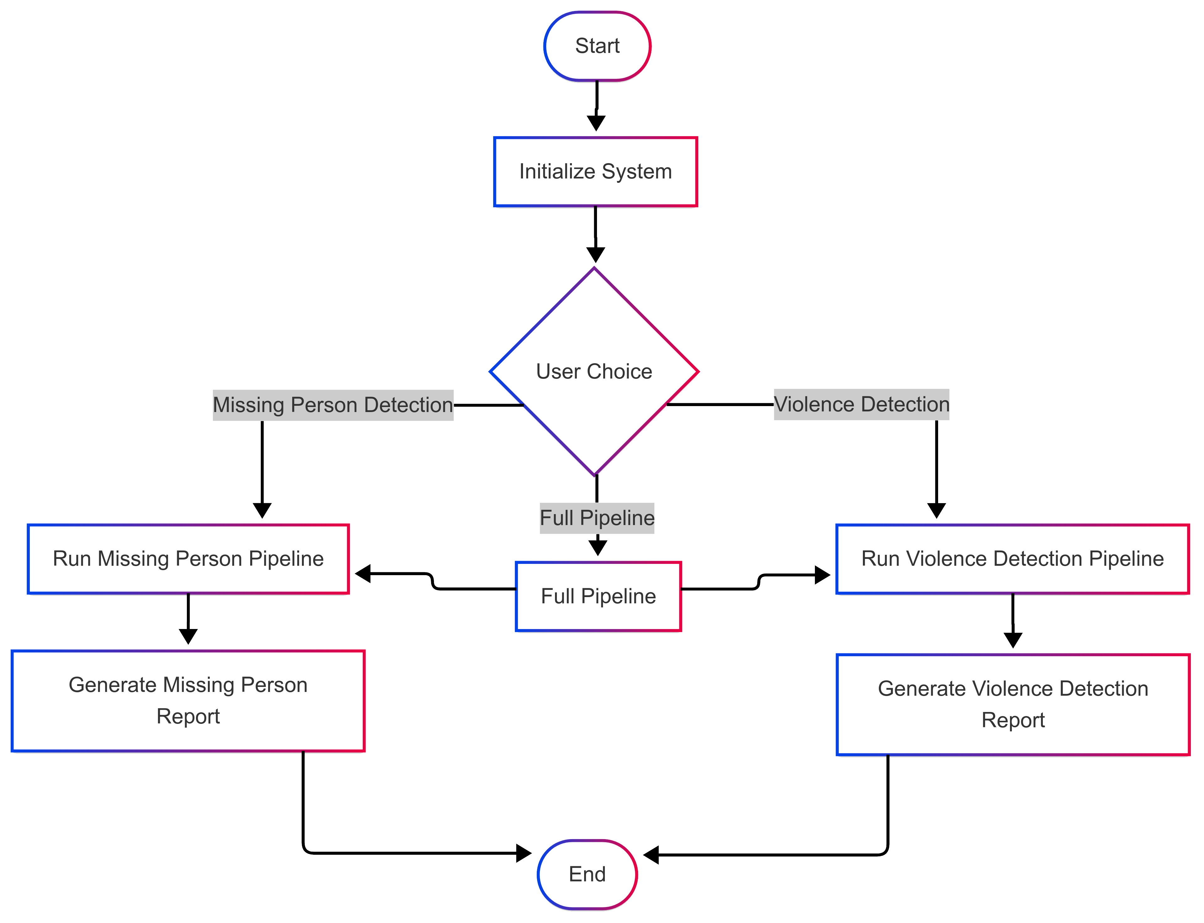
ARCHITECTURE
PERSON RE-IDENTIFICATION USING DEEP LEARNING AND BIG DATA METHODS
Overview
The project is designed to detect missing persons in video footage
and identify violent activities using deep learning.
It consists of two main pipelines:
Missing Person Detection
Violence Detection
Dept.of CSE,MACE,Kothamangalam
8

Slide 14
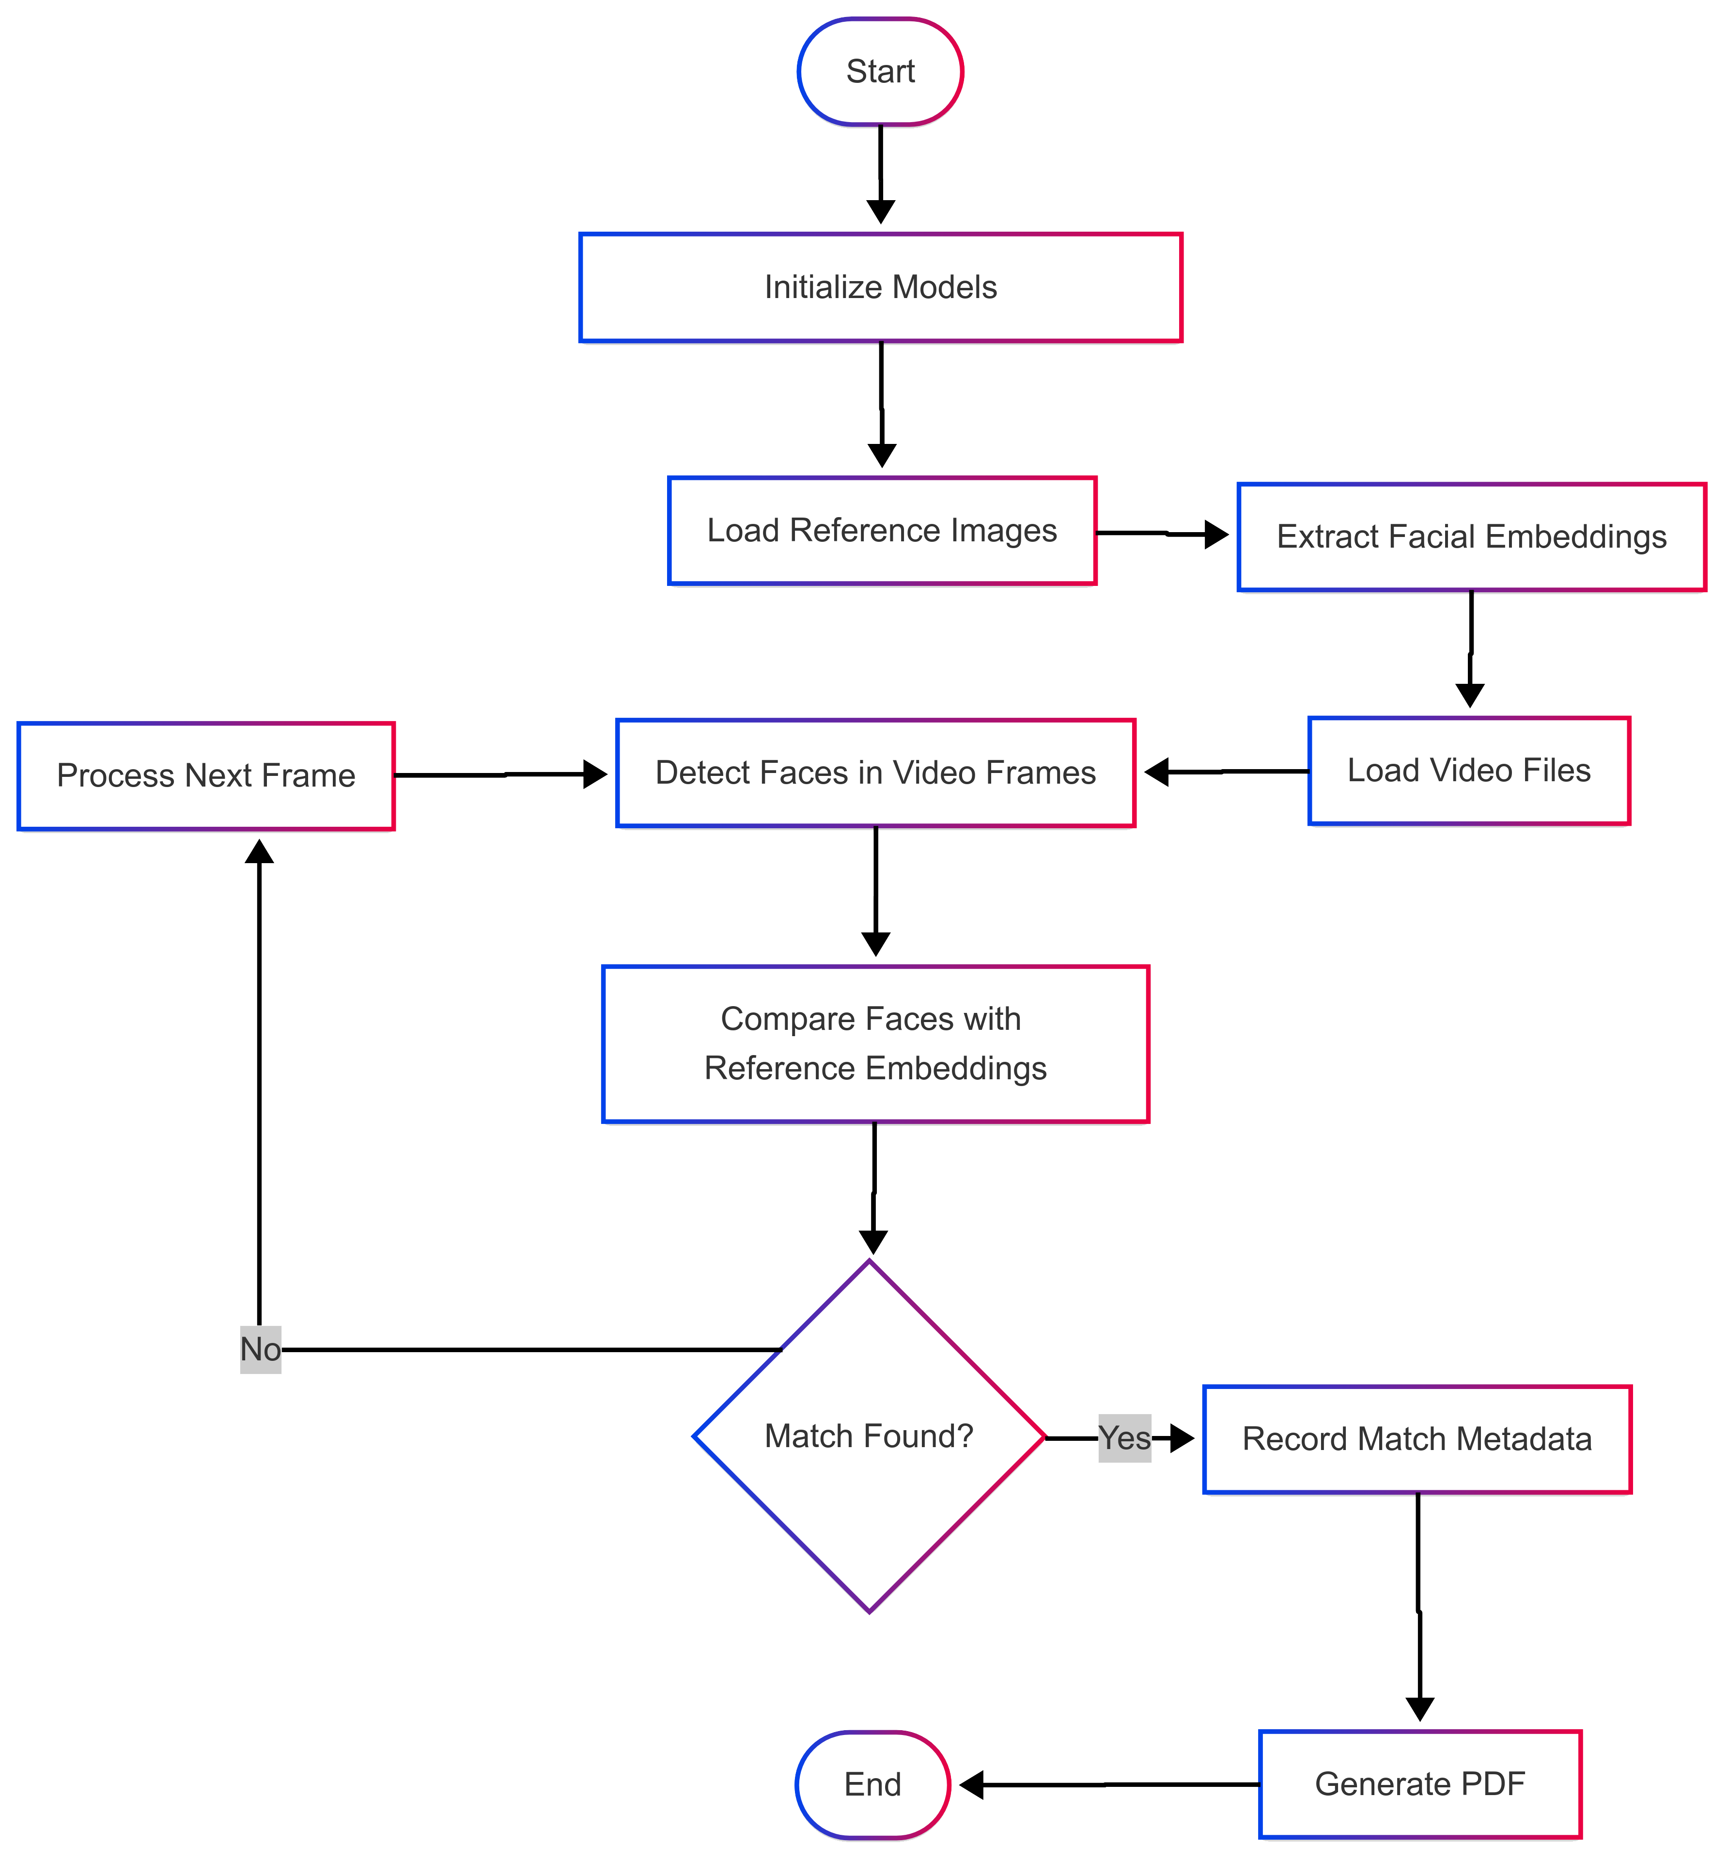
PERSON RE-IDENTIFICATION USING DEEP LEARNING AND BIG DATA METHODS
Missing Person Detection Pipeline
1. Setup and Initialization
Loads MTCNN for face detection and InceptionResnetV1 for face recognition.
Checks for GPU availability and optimizes processing accordingly.
2. Reference Image Loading
User provides reference images of the missing person.
The system extracts facial embeddings using InceptionResnetV1 and stores them for comparison.
3. Video File Processing
User selects video files for analysis.
The system extracts frames and detects faces using MTCNN.
4. Face Comparison
Compares detected faces with stored reference embeddings using cosine similarity.
If similarity exceeds a threshold (e.g., 0.65), it is marked as a potential match.
5. Detection and Reporting
Matches are recorded with frame index, timestamp, similarity score, and detected clothing color.
A PDF report is generated with detected images and metadata.
Dept.of CSE,MACE,Kothamangalam
8

Slide 15
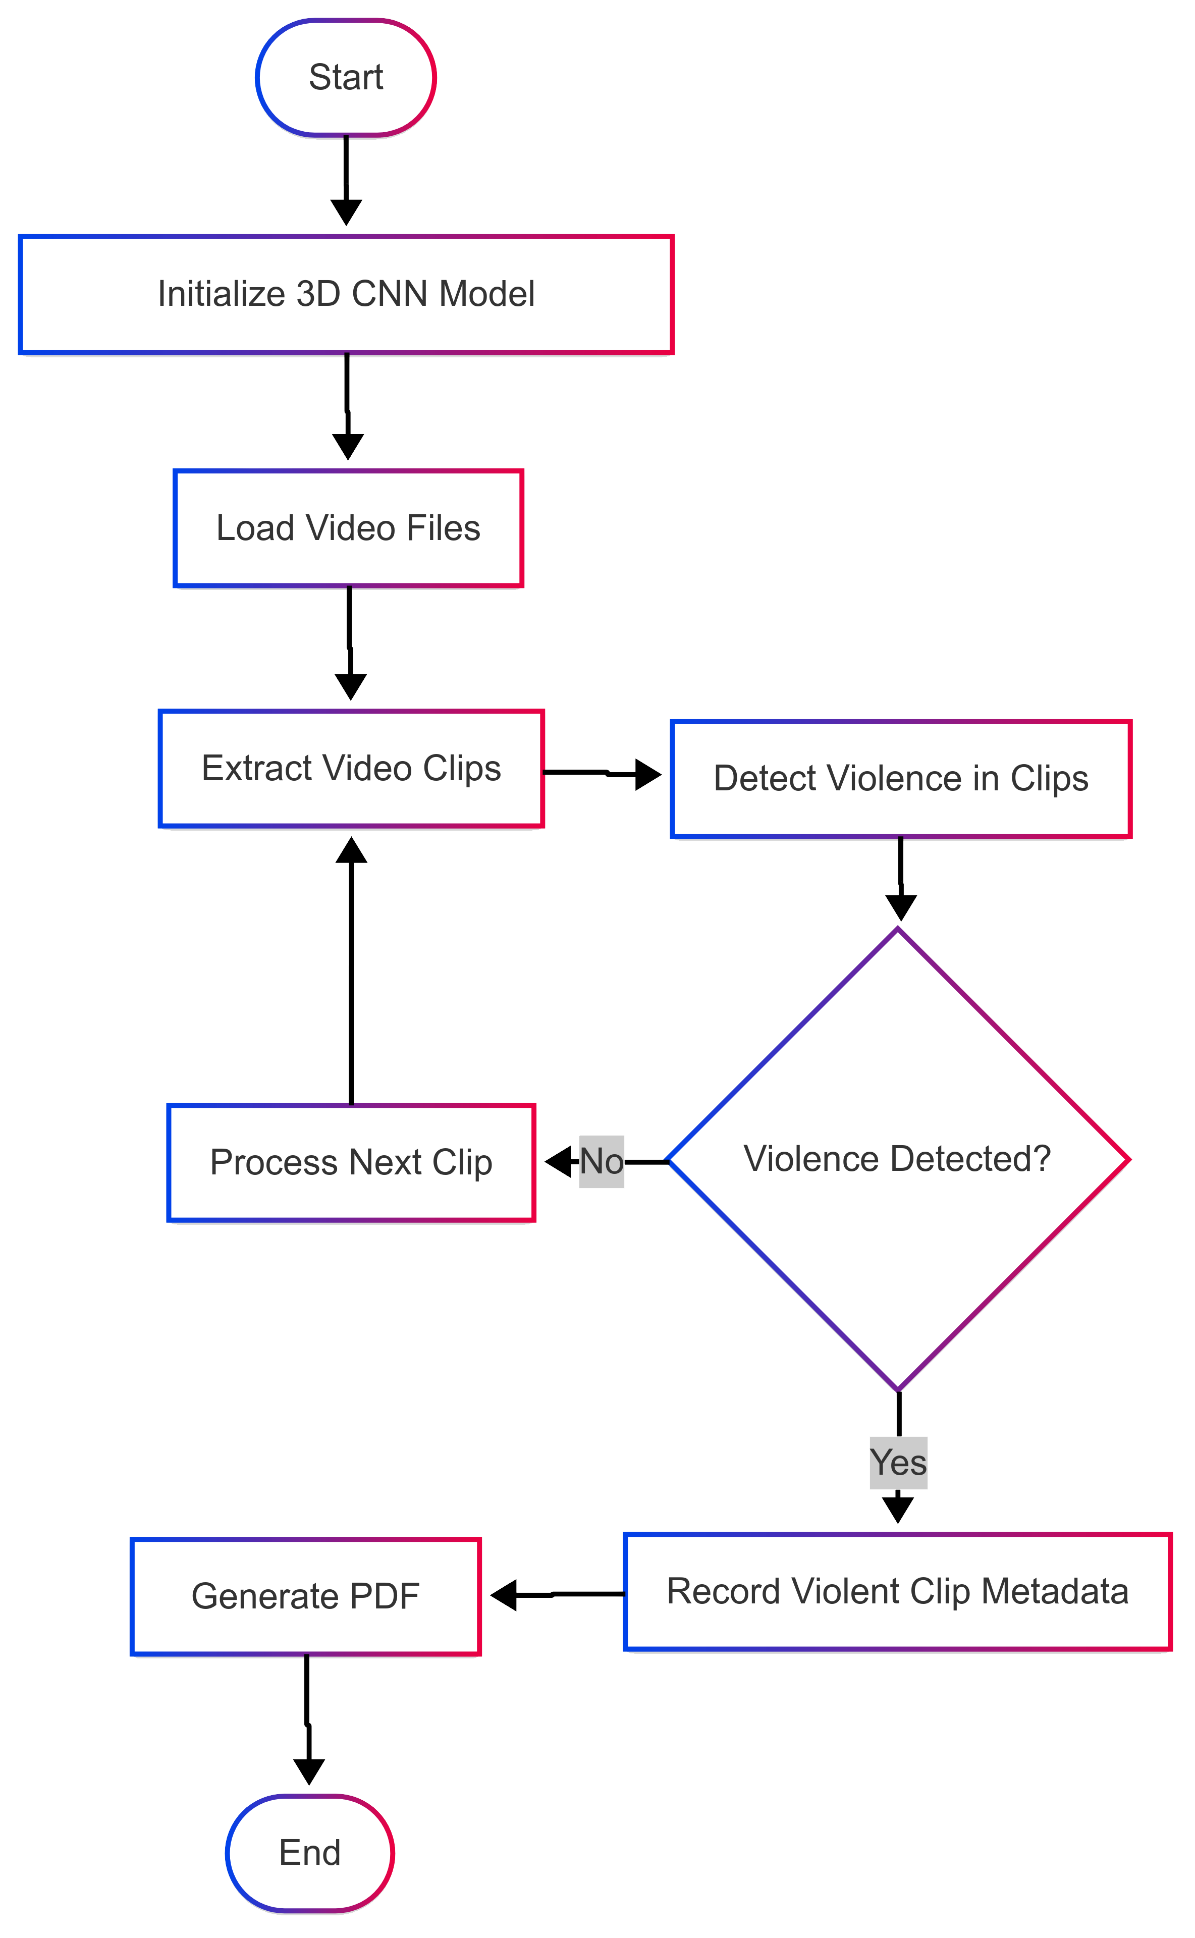
PERSON RE-IDENTIFICATION USING DEEP LEARNING AND BIG DATA METHODS
Violence Detection Pipeline
1. Setup and Initialization
Loads a 3D CNN model (R3D-18) for violence detection.
Deploys the model on GPU or CPU for faster inference.
2. Video File Processing
User selects video files for analysis.
The system extracts video clips, each containing a sequence of frames.
3. Violence Detection
Clips are analyzed using the 3D CNN model to classify violence vs. non-violence.
If the probability of violence exceeds 0.65, the clip is flagged.
4. Detection and Reporting
Identified violent incidents are recorded with timestamp, probability score, and a preview thumbnail.
A PDF report is generated summarizing the detected violence cases.
Dept.of CSE,MACE,Kothamangalam
8

Slide 16
PERSON RE-IDENTIFICATION USING DEEP LEARNING AND BIG DATA METHODS
Technologies & Models Used
1. Face Detection & Recognition
MTCNN → Detects faces in video frames.
InceptionResnetV1 → Extracts facial embeddings and matches with reference images.
Cosine Similarity → Measures how similar two faces are.
2. Violence Detection
R3D-18 (3D CNN Model) → Learns temporal patterns in video sequences for violence detection.
Softmax Activation → Outputs probability scores for classification.
3. User Interface & Reporting
Tkinter → GUI for file selection and results display.
FPDF → Generates PDF reports with timestamps and detection details.
4. Video Processing & Optimization
OpenCV & PIL → Handles frame extraction, image processing, and display.
ThreadPoolExecutor (Parallel Processing) → Speeds up video analysis by processing multiple frames simultaneously.
CUDA & PyTorch → Uses GPU acceleration for deep learning inference.
Dept.of CSE,MACE,Kothamangalam
8

Slide 17
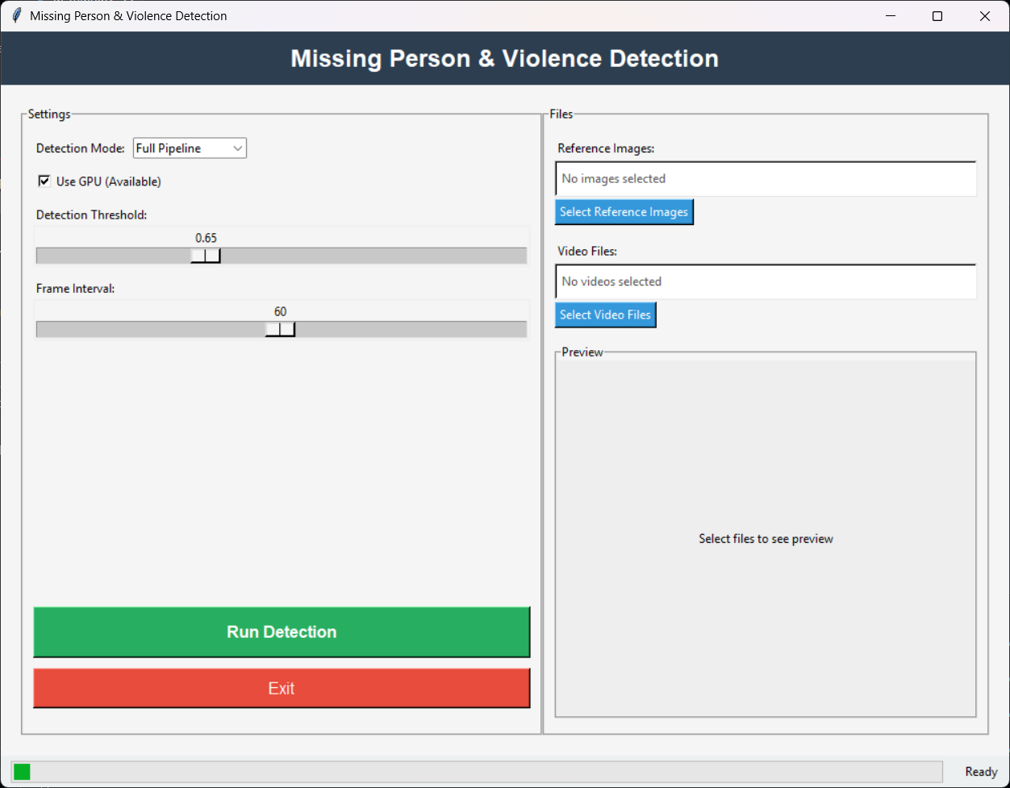
IMPLEMENTATION
PERSON RE-IDENTIFICATION USING DEEP LEARNING AND BIG DATA METHODS
Dept.of CSE,MACE,Kothamangalam
10

Slide 18
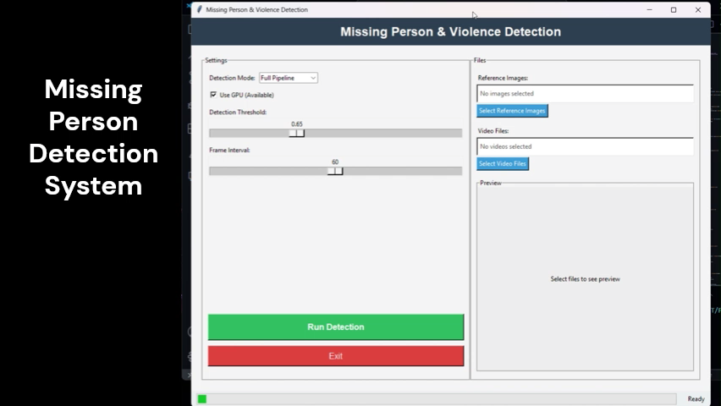
PERSON RE-IDENTIFICATION USING DEEP LEARNING AND BIG DATA METHODS
Dept.of CSE,MACE,Kothamangalam
10

Slide 19
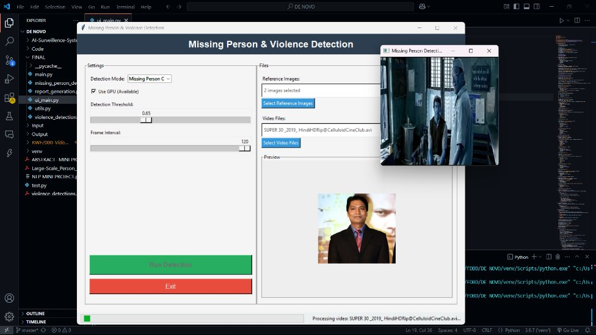


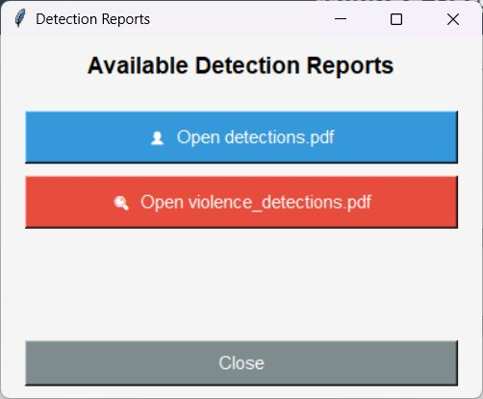
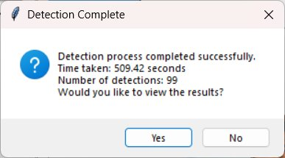

Slide 20
DIVISION OF WORK
PERSON RE-IDENTIFICATION USING DEEP LEARNING AND BIG DATA METHODS
Face Recognition Pipeline
Violence Detection Pipeline
Parallel Processing & Multi-Threading
GUI Development
Command-Line Execution & Workflow Management
PDF Report Generation
Accuracy & Threshold Tuning
System Testing & Debugging
Dept.of CSE,MACE,Kothamangalam
11

Slide 21
RESULT
PERSON RE-IDENTIFICATION USING DEEP LEARNING AND BIG DATA METHODS
Missing Person Detection
Successfully identified missing persons from video footage.
Achieved accurate face recognition using MTCNN + InceptionResnetV1.
Reduced processing time with GPU acceleration and parallel processing.
Violence Detection
Effectively detected violent activities using 3D CNN (R3D-18).
Minimized false positives through optimized frame sampling and classification thresholds.
Performance & Optimization
Faster video analysis using multi-threading (ThreadPoolExecutor).
High detection accuracy in real-world test cases.
Scalability – Efficient processing of large CCTV datasets.
Generated Reports
Automated PDF reports with detected faces, timestamps, similarity scores, and violence detection summaries.
Dept.of CSE,MACE,Kothamangalam
12

Slide 22
PERSON RE-IDENTIFICATION USING DEEP LEARNING AND BIG DATA METHODS
FUTURE SCOPE
Enhancing Real-Time Processing
Improve GPU utilization for faster inference on live CCTV feeds.
Implement edge computing to process data closer to the source.
Advanced Face Recognition Techniques
Integrate transformer-based models (e.g., Vision Transformers, ArcFace) for improved accuracy.
Enhance robustness to occlusions, low-light conditions, and pose variations.
Use multi-modal analysis (video + audio) for better detection accuracy.
Scalability & Cloud Deployment
Develop a cloud-based solution for large-scale video processing.
Enable integration with law enforcement and surveillance networks.
Integration with Smart City Infrastructure
Deploy in public surveillance systems, transport hubs, and law enforcement databases.
Dept.of CSE,MACE,Kothamangalam
13

Slide 23
CONCLUSION
PERSON RE-IDENTIFICATION USING DEEP LEARNING AND BIG DATA METHODS
This project successfully enhances CCTV surveillance by automating missing person identification and violence detection using deep learning. By integrating MTCNN, InceptionResnetV1, and 3D CNNs, along with GPU acceleration and parallel processing, the system achieves faster and more accurate analysis of large-scale video footage. The results demonstrate efficient face recognition, optimized violence detection, and automated reporting, making the system a valuable tool for law enforcement and security applications. Future improvements will focus on real-time processing, enhanced AI models, and large-scale deployment for broader impact.
Dept.of CSE,MACE,Kothamangalam
14

Slide 24
REFERENCES
PERSON RE-IDENTIFICATION USING DEEP LEARNING AND BIG DATA METHODS
[1503.03832] FACENET: A UNIFIED EMBEDDING FOR FACE RECOGNITION AND CLUSTERING
OVERVIEW - SPARK 3.5.4 DOCUMENTATION
Dept.of CSE,MACE,Kothamangalam
15

Slide 25
THANK YOU
PERSON RE-IDENTIFICATION USING DEEP LEARNING AND BIG DATA METHODS
Dept.of CSE,MACE,Kothamangalam
16

